Slide 1
AirBnB: System Analysis
Maastricht University SBE 2019
Iryna
Madalina
Alessandro
Hugo

Slide 2
5+Million
PLACES TO STAY
Notes:
Hugo

Slide 3

191
COUNTRIES
Notes:
Hugo

Slide 4

Notes:
Hugo

Slide 5

Agenda
What is AirBnB?
How do you book on AirBnB?
System Design Analysis of the booking process
E-R diagram
DFD diagram
Use case
Context diagram
Problematic areas in the system design
Proposed solution
Notes:
Hugo

Slide 6
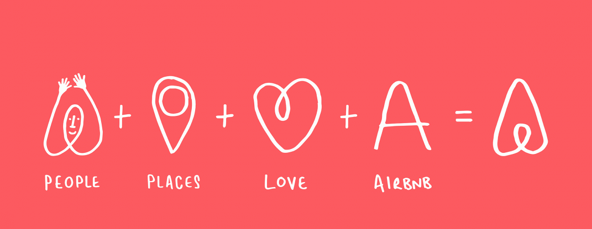
WHAT IS AirBnB?
Notes:
Hugo

Slide 7
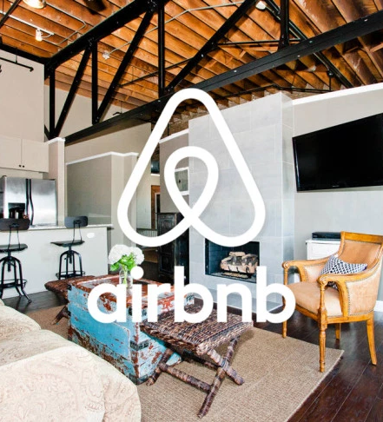
Founded in 2007 in San Francisco, USA
Business model based on host-guest interaction
1 host 1 house policy in historic city centers
4.3 nights average stay
Notes:
Hugo

Slide 8
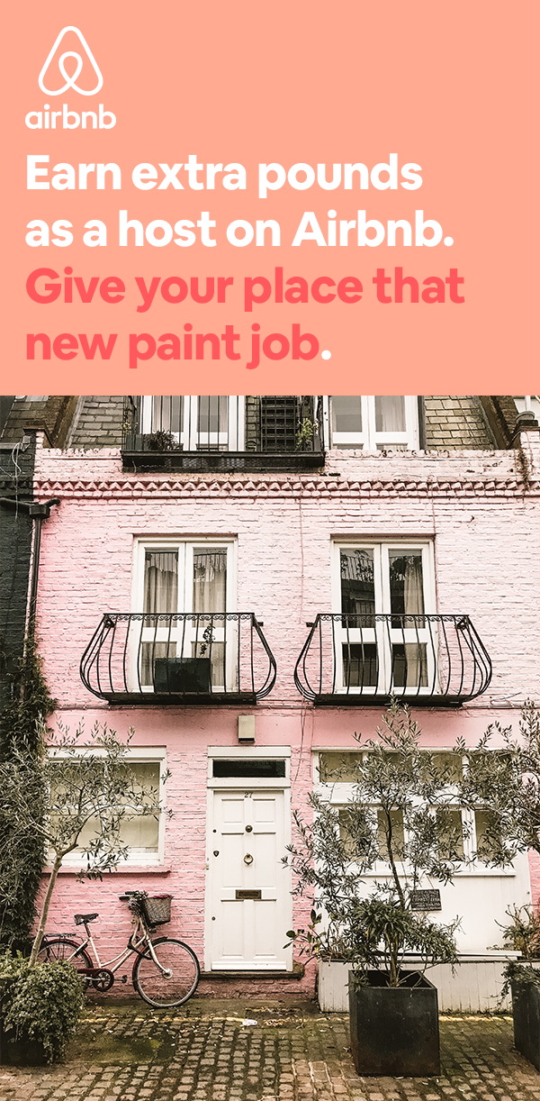

Air mattresses
Air Bed and Breakfast
Breakfast and city tours
Notes:
Hugo

Slide 9
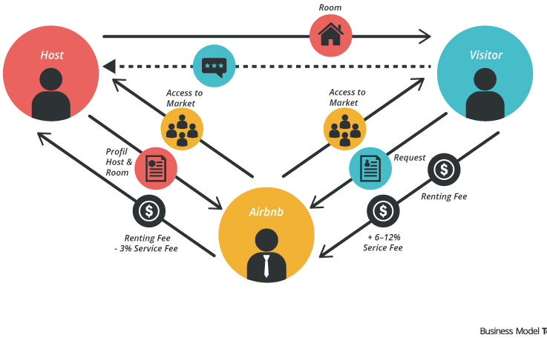
How do you book on AirBnB?
AirBnB acts as intermediary
Properties with >10 reviews are the most booked
Host has to accept the guest request
Payment is secured through AirBnB
Issues with the app can arise after the booking
Notes:
Hugo

Slide 10
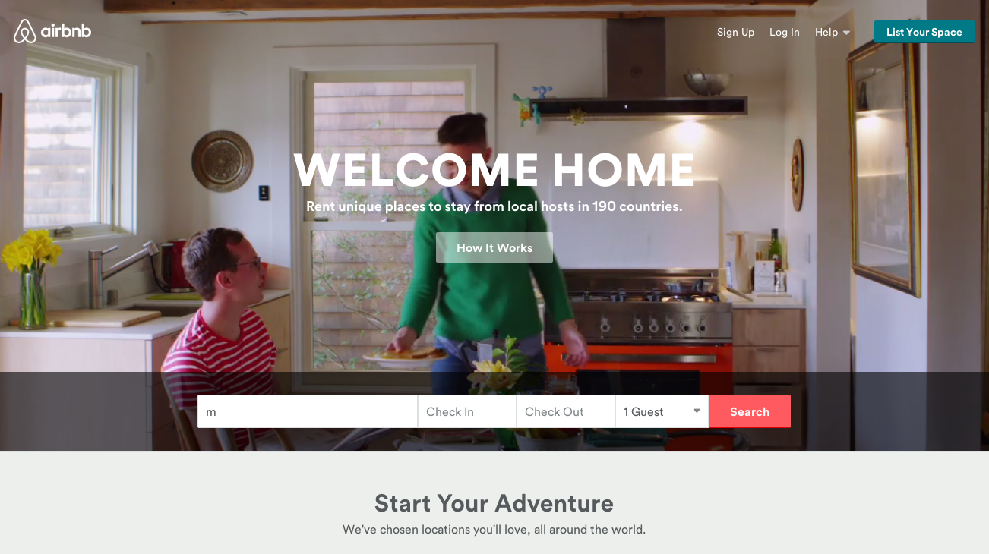
Notes:
Hugo

Slide 11
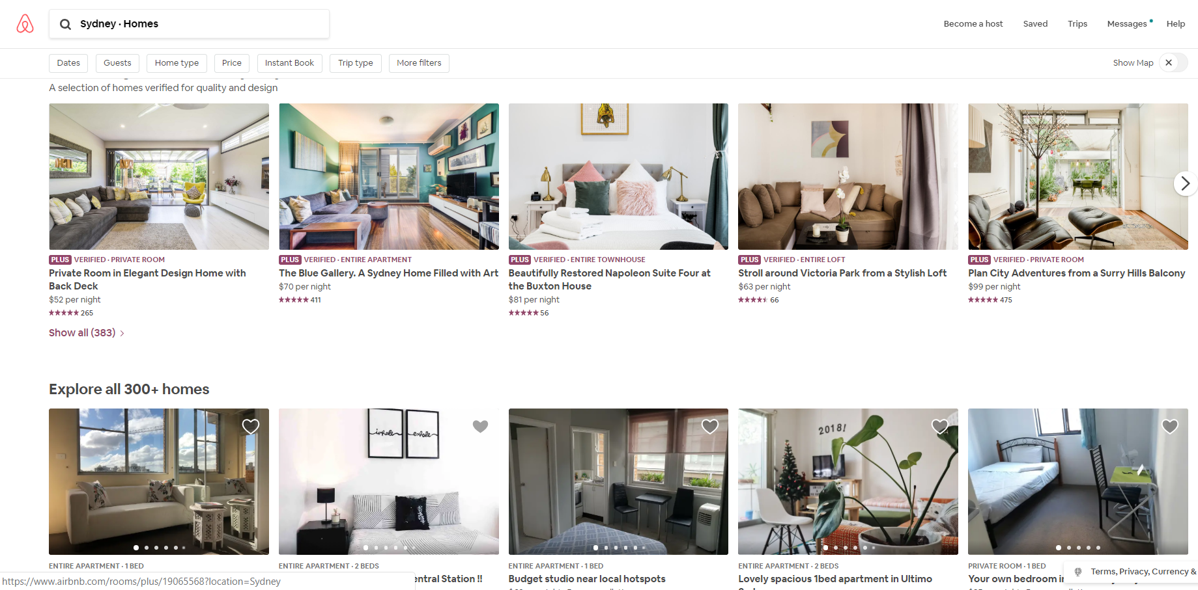
Notes:
Hugo

Slide 12
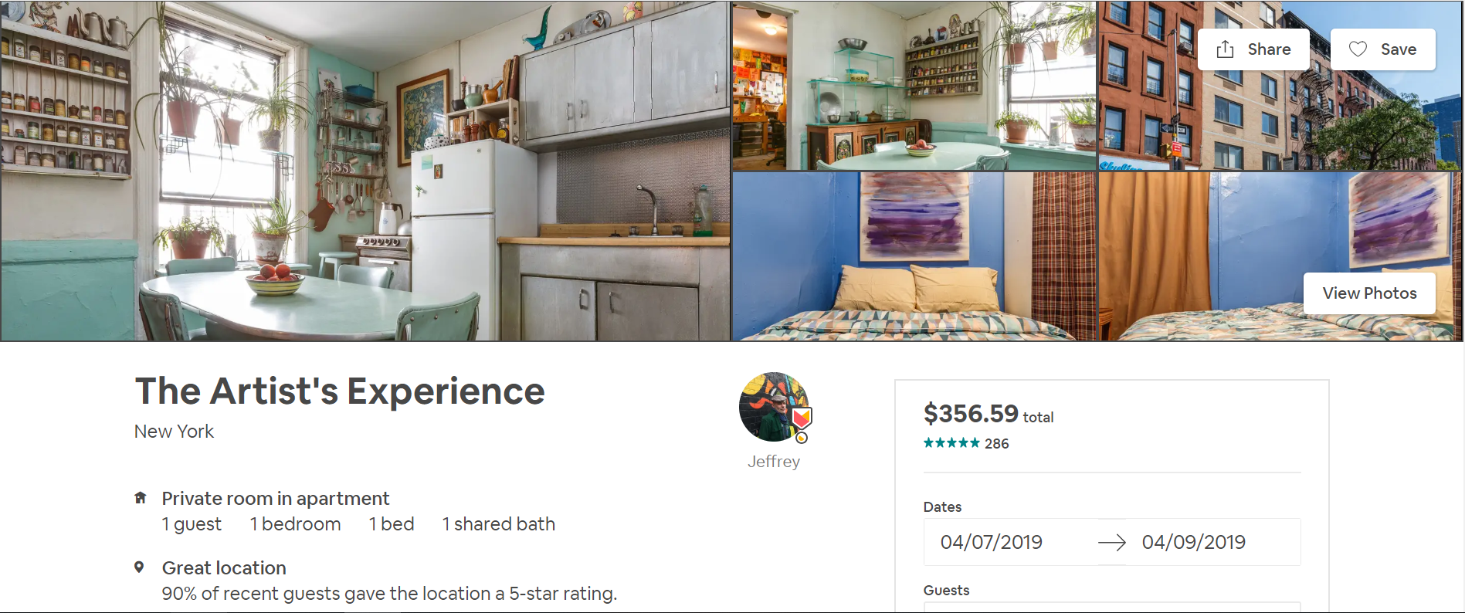
Notes:
Hugo

Slide 13
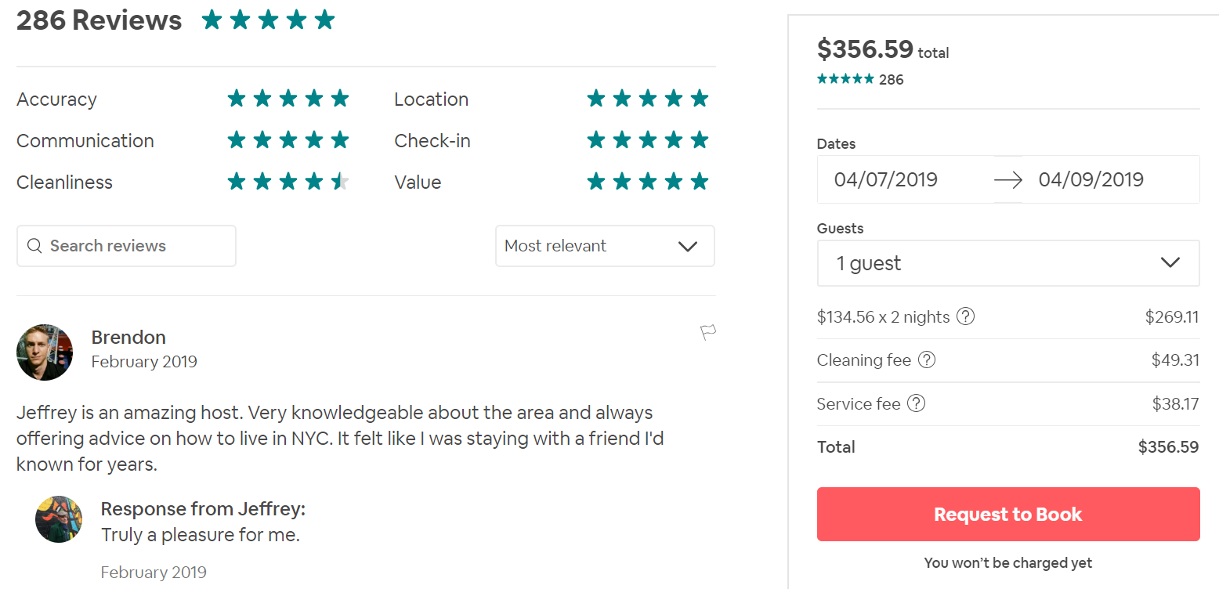
Notes:
Hugo

Slide 14
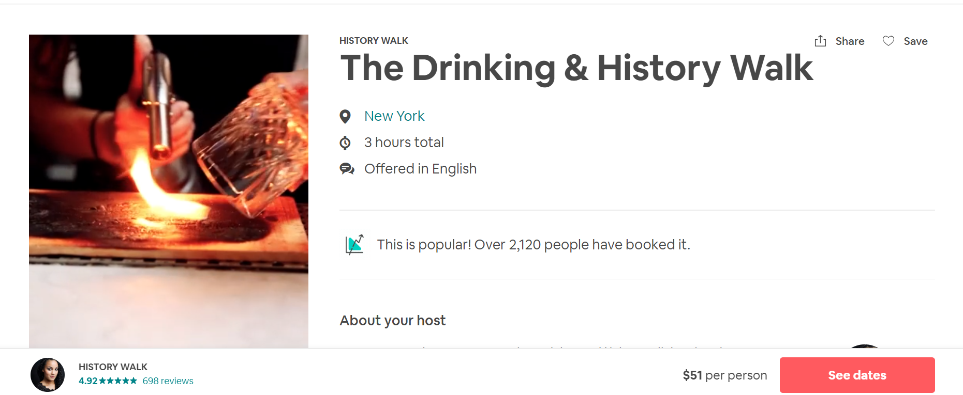
Extra activities also available
Notes:
Hugo

Slide 15
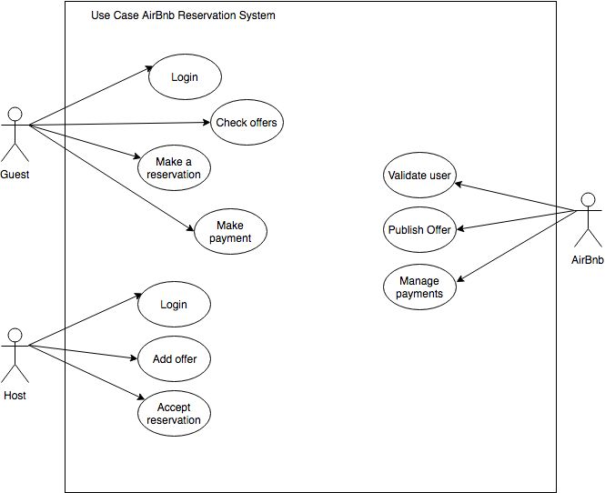
Use Case
Notes:
Alessandro

Slide 16
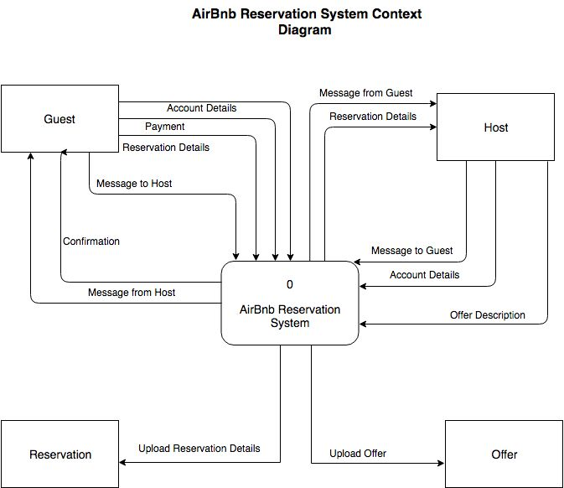
Context diagram
Notes:
Alessandro

Slide 17
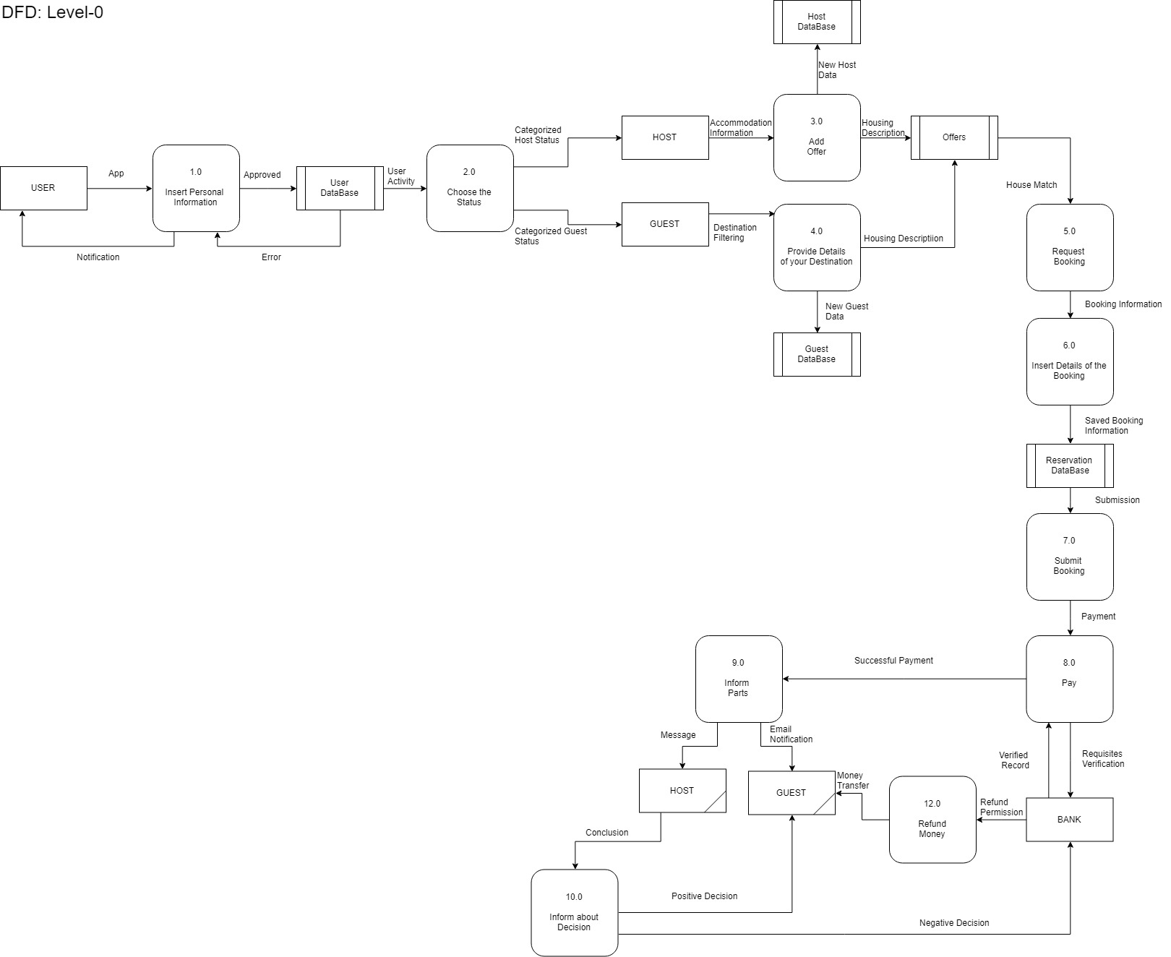
DFD - L0
Notes:
Mada

Slide 18
Notes:
Mada

Slide 19
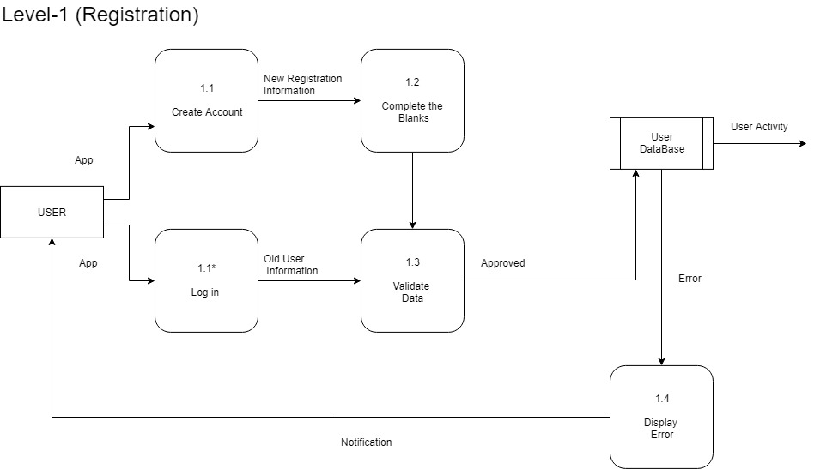
Notes:
Mada

Slide 20
Notes:
Mada

Slide 21
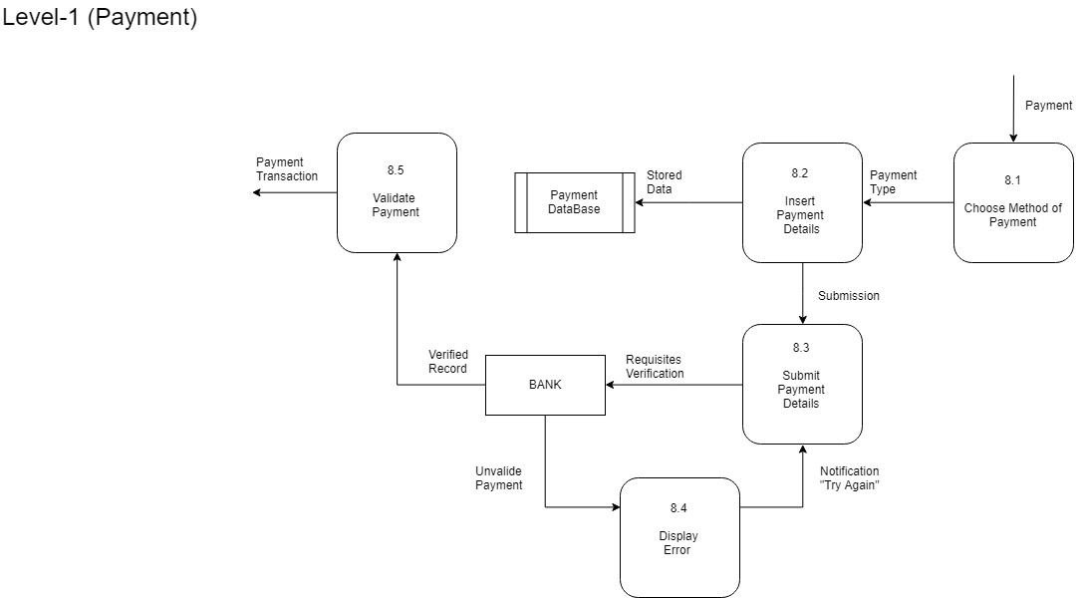
Notes:
Mada

Slide 22
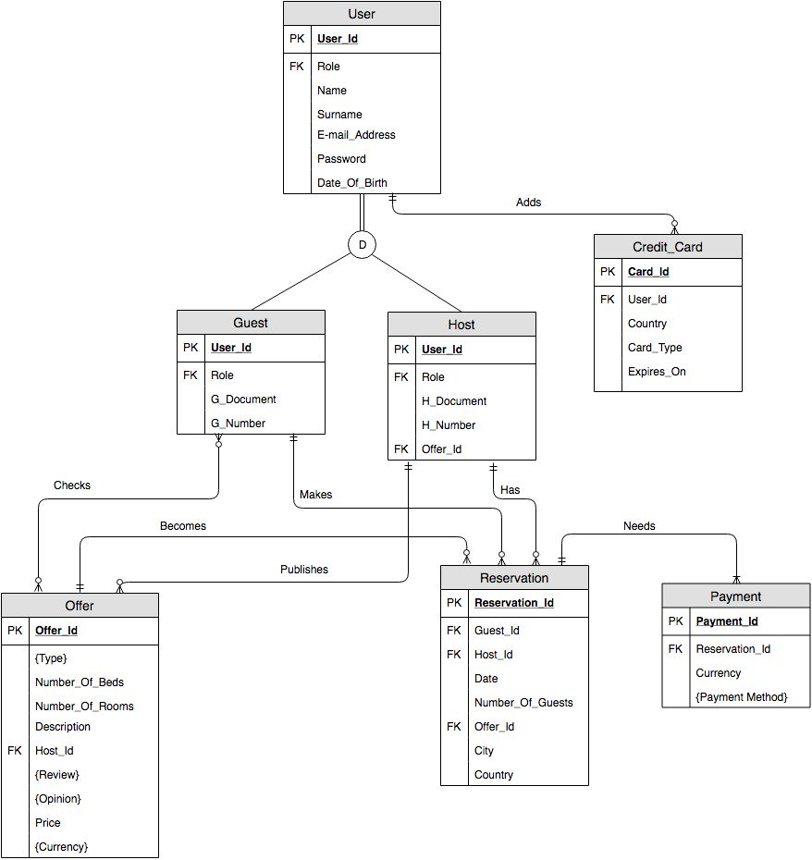
E-R
Notes:
Iryna

Slide 24

PROBLEMATIC AREA
-?
Notes:
Iryna

Slide 25

Proposed solution
Notes:
Iryna

Slide 26
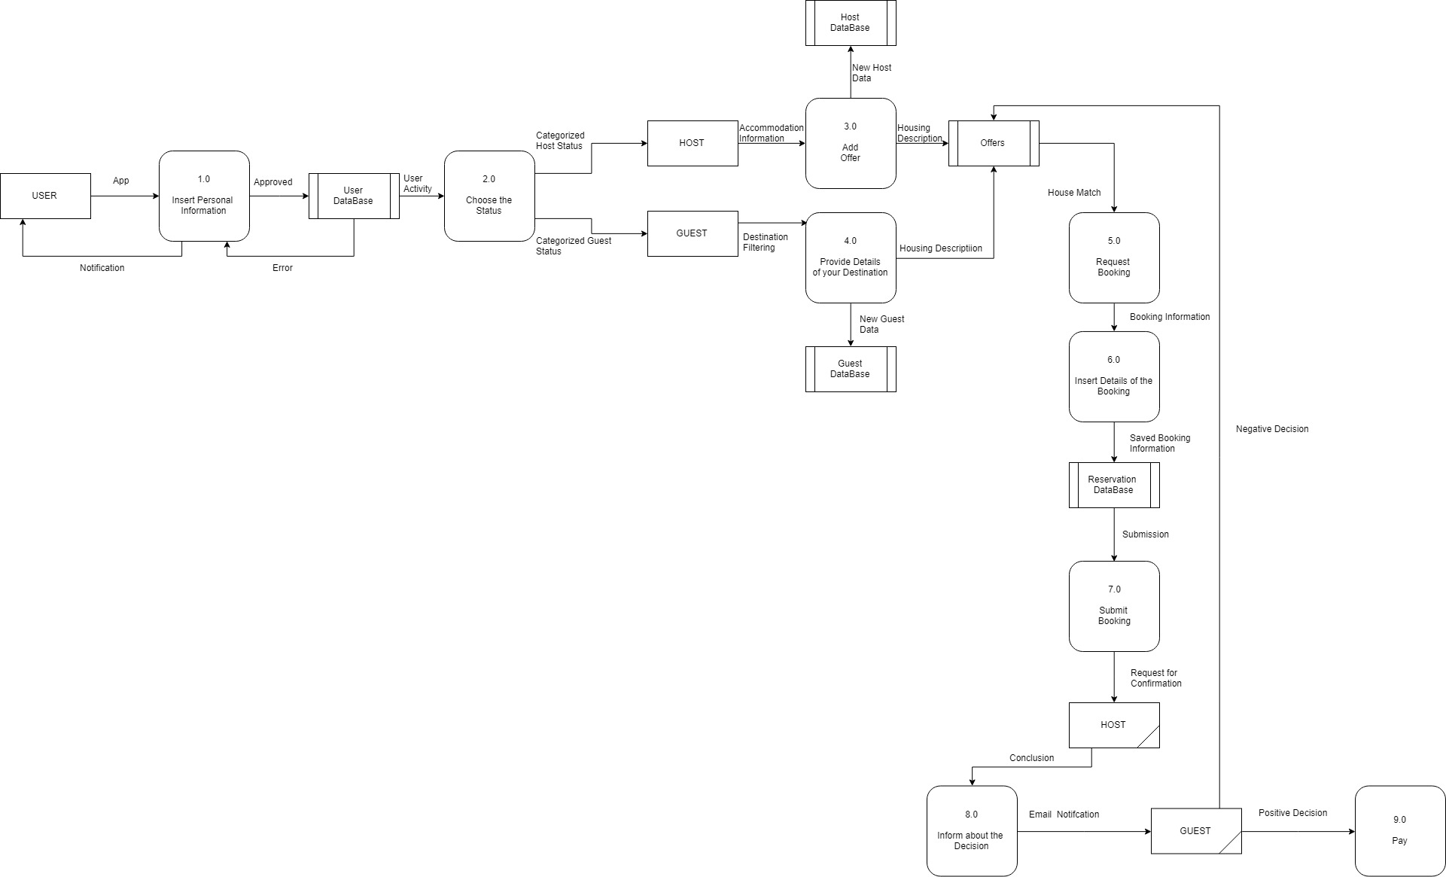
Notes:
Iryna

Slide 27
CONCLUSION
Notes:
Iryna

Slide 28
THANK YOU!

Slide 29
References
https://towardsdatascience.com/statistical-overview-of-barcelonas-airbnb-market-83dc7d6be648
https://www.airbnb.com/
https://www.traveltripper.com/blog/how-airbnbs-latest-announcements-may-transform-the-online-booking-space/

